Slide 1
SE3SL11
“The course with no name…”
Pat Parslow
p.parslow@reading.ac.uk
Room 127
Pat Parslow, Room 127, P.Parslow@reading.ac.uk

Slide 2
SE3SL11
SLEASE
ELSIE
PLEASE
Pat Parslow, Room 127, P.Parslow@reading.ac.uk

Slide 3
SE3SL11
Professional
Social
Legal
Ethical
- Things you need to consider
Pat Parslow, Room 127, P.Parslow@reading.ac.uk

Slide 4
SE3SL11
BCS, IEEE, IET, RAE – professional bodies
Codes of professional conduct
Find the codes of conduct – read them
Pat Parslow, Room 127, P.Parslow@reading.ac.uk

Slide 5

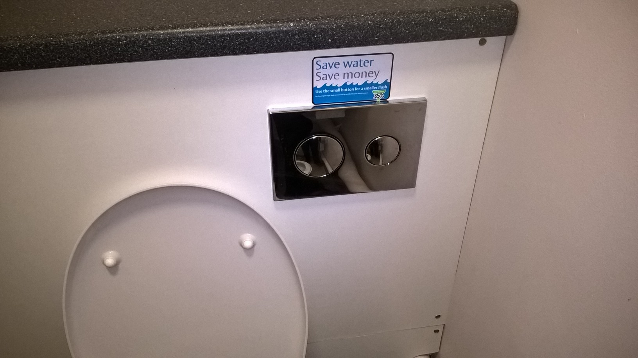
Only following orders…
Pat Parslow, Room 127, P.Parslow@reading.ac.uk

Slide 6
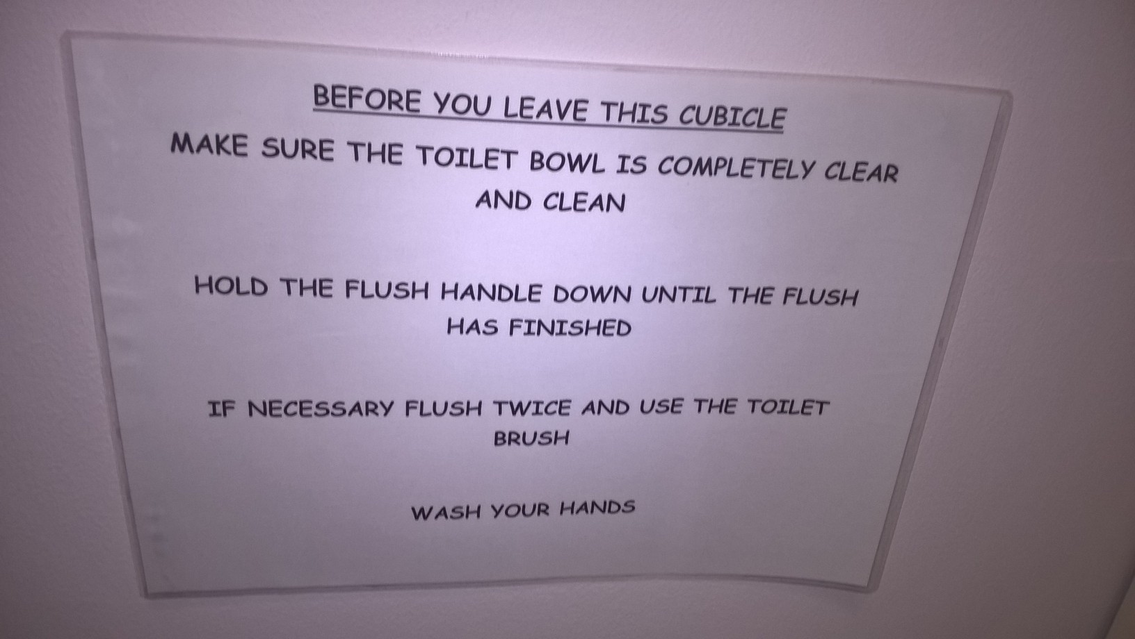
How am I with you now?
Pat Parslow, Room 127, P.Parslow@reading.ac.uk

Slide 7
SE3SL11
Social
Is what you are doing acceptable?
How do social views change?
Regional/sub-culture/temporal
Pat Parslow, Room 127, P.Parslow@reading.ac.uk

Slide 8
SE3SL11
Legal
Is what you are doing legal/lawful?
How do laws change?
Regional/sub-culture/temporal
Pat Parslow, Room 127, P.Parslow@reading.ac.uk

Slide 9
SE3SL11
Ethical
Is what you are doing good/bad?
How do ethics change?
Regional/sub-culture/temporal
Pat Parslow, Room 127, P.Parslow@reading.ac.uk

Slide 10
Old and new news…
Xerox – “You had 1 job, Xerox, 8 job”
  Jbig2 compression
VW – deliberately cheating emission tests
  Fairly clever software, any legitimate use?
  In one case, financial, health and safety concerns
  In the other, environmental, health, and reputation
Pat Parslow, Room 127, P.Parslow@reading.ac.uk

Slide 11
SE3SL11
Do Social/Legal/Ethical/Professional
issues apply to Project X?
If your project neither relies on,
nor affects in any way,
Society,
Is it something worth doing?
Pat Parslow, Room 127, P.Parslow@reading.ac.uk

Slide 12
SE3SL11
As:
IT professionals
Engineers
Software Engineers
anyone in the IT industries…
Can you just be ‘the techie’?
Pat Parslow, Room 127, P.Parslow@reading.ac.uk

Slide 13
SE3SL11
The Royal Academy of Engineering
Ethical Principles
Accuracy and Rigour
Honesty and Integrity
Respect for Life, Law and the Public Good
Responsible Leadership: Listening and Informing
Pat Parslow, Room 127, P.Parslow@reading.ac.uk

Slide 14
SE3SL11
RAE Ethical Principles
Accuracy and Rigour
  keep their knowledge and skills up to date and assist the development of engineering knowledge and skills in others.
Continuing Professional Development
Pat Parslow, Room 127, P.Parslow@reading.ac.uk

Slide 15
SE3SL11
Continuing Professional Development
Social values, law, ethics…
(not to mention the technology itself)
All change over time.
You have to be prepared to learn
throughout your career
Pat Parslow, Room 127, P.Parslow@reading.ac.uk

Slide 16
SE3SL11
All change over time.
But it’s all a bit woolly isn’t it?
Not like real engineering…
Pat Parslow, Room 127, P.Parslow@reading.ac.uk

Slide 17
SE3SL11
All change over time.
Potentially changing through a project…
Requirements analysis
Stakeholder analysis
Risk analysis
Pat Parslow, Room 127, P.Parslow@reading.ac.uk

Slide 18
SE3SL11
Real impacts on projects
Let me tell you a story…
Pat Parslow, Room 127, P.Parslow@reading.ac.uk

Slide 19
SE3SL11
Blackboard
Course Documents/
Ethics
Legal
Read them
Pat Parslow, Room 127, P.Parslow@reading.ac.uk

